Slide 1
Object Oriented Programming II
Monday 3 December 2024

Slide 2
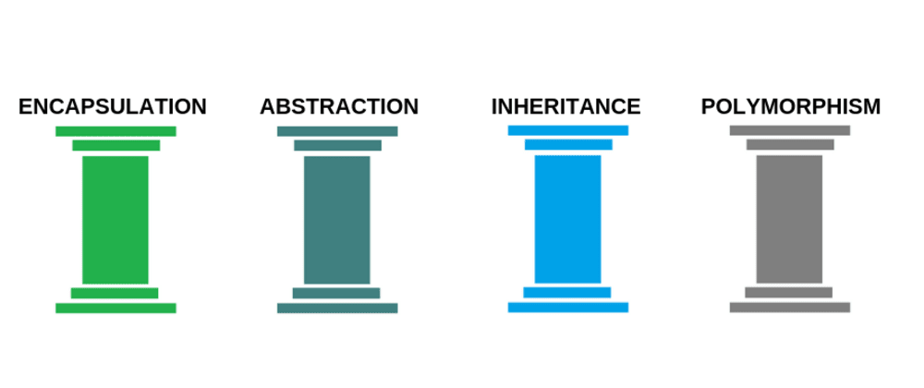
Samenvatting OOP I

Slide 3
Encapsulation
Encapsulation is the process of grouping functions and data into a single entity. To access these data members, the member function’s scope must be set to “public,” while the data members’ scope must be set to “private.” According to this theory, an item contains all important information; only a small subset is made available to the outside world. Each object has a private class that contains its implementation and state.

Slide 4
Abstraction
One of the OOP concepts is abstraction, which is the act of representing key features without including supporting information. It is a method for developing a brand-new data type appropriate for a particular application. It avoids providing extraneous or pointless facts and only displays the precise portion the user has requested.

Slide 5
Inheritance
inheritance refers to the process of gaining properties. One object in OOP inherits the properties of another. Developers can reuse common functionality while retaining a distinct hierarchy by assigning relationships and subclasses between items. This characteristic of OOP speeds up development and provides more accuracy by requiring a more in-depth investigation of the data. The parent-child relationship is symbolized via inheritance.

Slide 6
Overriding vs Overloading
Overriding occurs when the method signature is the same in the superclass and the child class. Overloading occurs when two or more methods in the same class have the same name but different parameters.

Slide 7
Polymorphism (Many Shapes / Many Forms)
Multiple classes can use the same method name using polymorphism, which also involves redefining methods for derived classes. Compile-time polymorphism and run-time polymorphism are the two different types of polymorphism. In addition to having several forms, objects are made to have shared behaviors. To avoid writing duplicate code, the software will determine which usage or meaning is required for each time an object from a parent class is used.

Slide 8
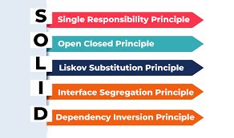
OOP 2

Slide 9
Single Responsibility Principle (SRP)
A class should have ONE and ONLY ONE reason to change *** 1 Responsibility Characteristics: - Should be able to explain what an application is doing in 1 single line
Main problem it solved:
- Re-usability

Slide 10
Open Closed Principle
Software entities should be open for extension but closed for modification

Slide 11
Liskov Subsitituion Principle (LSP)
Subtypes must be a substitutable for their base types.
*** Follow “IS-A” method
DO’s Rectangle is a shape
Circle is a shape
PassengerVehicle is a Vehicle
Employee is a Person
DON’T’s
Rectangle is not a square

Slide 12
Interface Segregation Principle (ISP)
Clients should not be forced to implement interfaces they don’t use.
Instead of one fat interface many small interfaces are preferred based on groups of methods, each one serving one submodule.

Slide 13
Dependency Inversion Principle (DIP)
DEPEND upon interfaces or abstractions, NOT upon concrete classes High level objects should not depend on low level implementations

Slide 14
Vragen?

